Slide 1
Virtual Twinning to Analyze and Predict Circuit Failure
Caroline Van Neste, Claire Hopfensperger, Jess Grady
Advisors: Dr. Scott and Dr. Jamieson
Electrical and Computer Engineering
Notes:
Jess: Welcome to our presentation for ECE448, our project is:

Slide 2
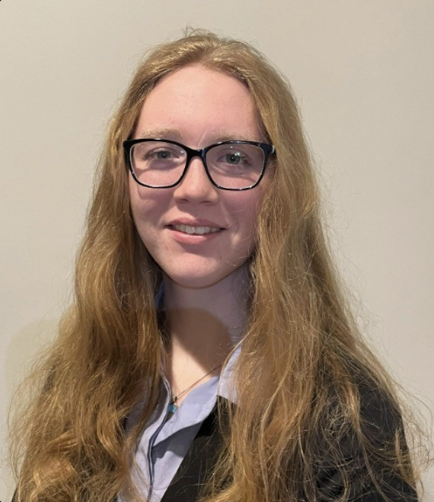
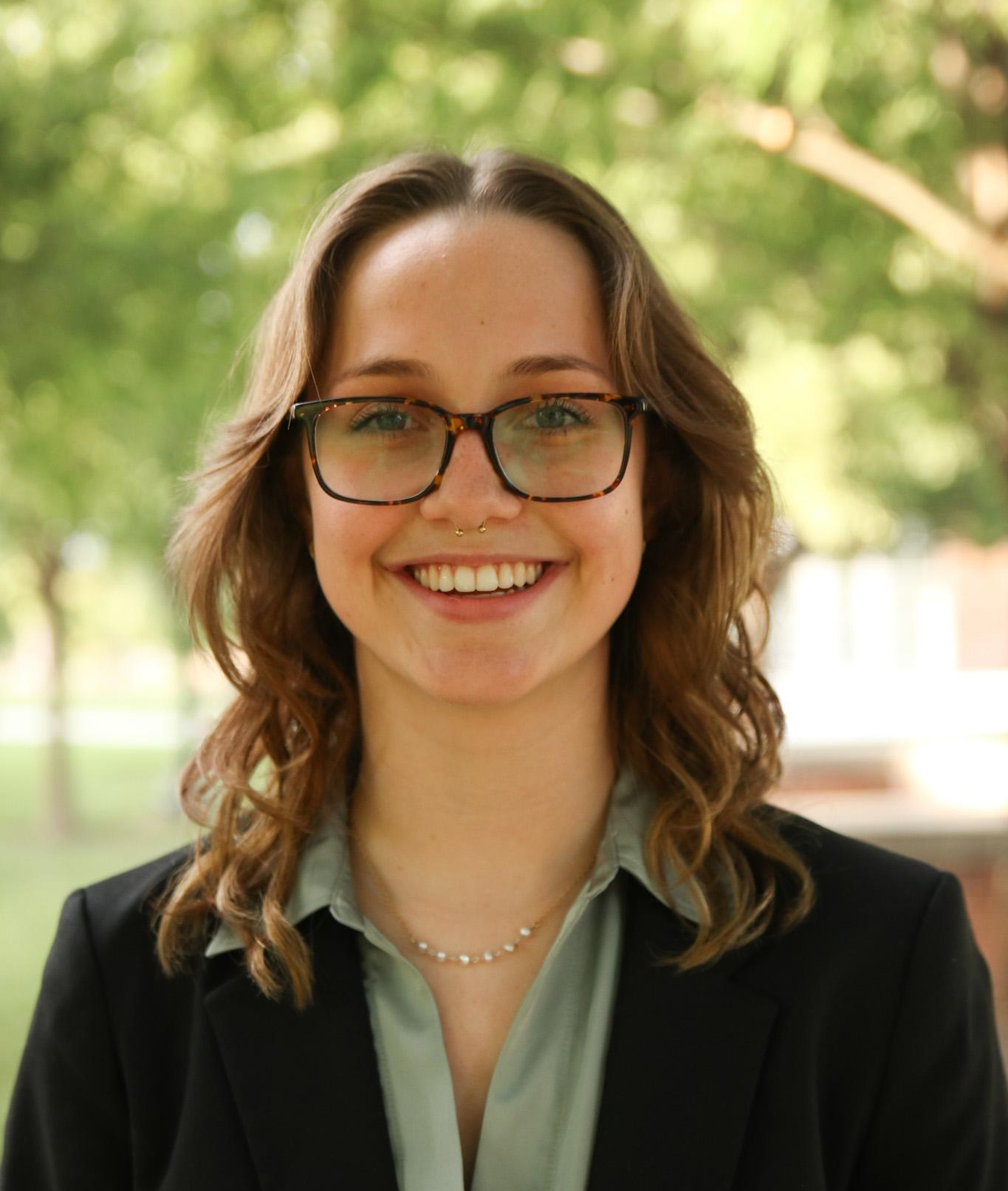
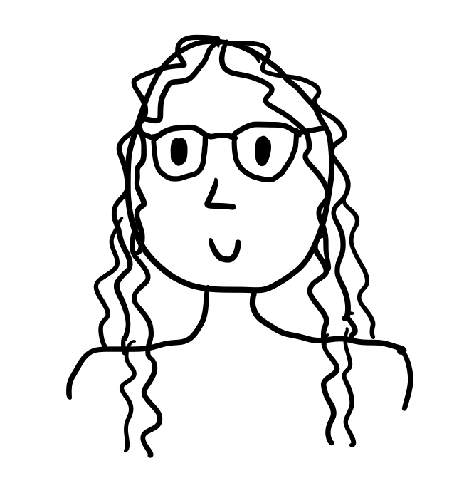

Meet the Team!
Caroline Van Neste
Electrical
(She/Her)
Claire Hopfensperger
Computer & Electrical
(She/Her)
Jess Grady Electrical (She\Her)
2

Slide 3




Background
Notes:
// add intro sentence about what we’re trying to do: we are trying to build a simulation model of a simple circuit to predict circuit failure
Jess: We are attempting to make a virtual twin of a component of a basic electrical circuit. A virtual twin at a high level is a digital representation of a physical system, that could be something as large as a building with all of its circuits and moving parts or just a single component that makes up part of a larger whole. \ In order to build one first a baseline needs to be built that includes measurements of both working and non working components, these are needed so that decisions can be made about if or when something is going to fail instead of waiting for that part to fail. This allows for comparison of what is happening in the real world with multiple simulated versions of the same component at various stages in the component life cycle.
We chose to analyze and build a model of a circuit containing an electrolytic capacitor as it ages in multiple manners. We chose these are they are one of the most commonly used components in electronic devices and are responsible for nearly 60% of failures in power electronics.

Slide 4
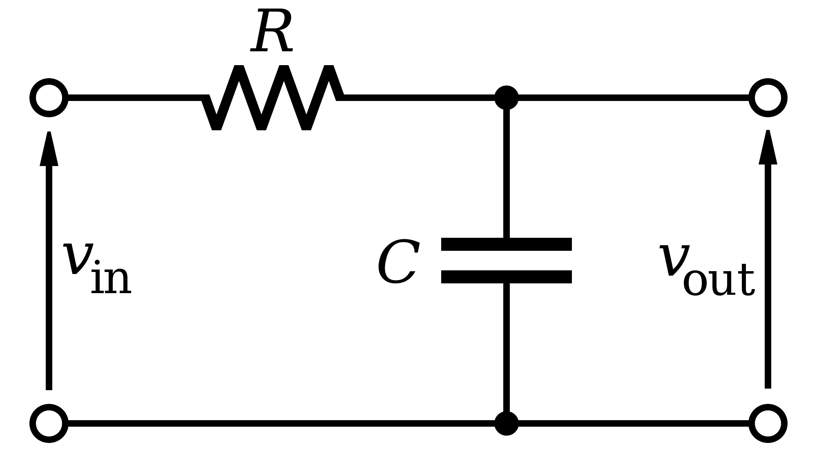
Low-Pass Filter
4
Notes:
Claire: We chose our system under test (SUT) to be a resistor-capacitor (RC) low-pass filter. Low-pass filters are commonly used in a large variety of circuits and systems as their design is simple and easily implementable. The simplicity of the circuit design allowed us to start with a basic circuit model and build from there if needed.
Since an RC low-pass filter just contains a voltage source, a resistor, and a capacitor, we will be able to better observe and analyze the behavior of the contained capacitor without influences from components in a more complex circuit.
Our idea was that if we could develop an accurate and reliable digital twin of this simple low-pass filter, then we could expand on it and develop models of more complicated systems.

Slide 5
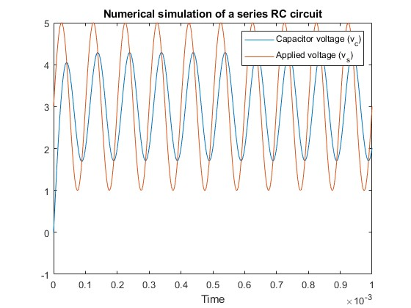
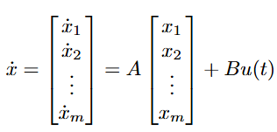
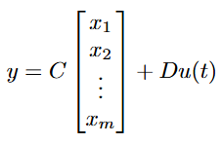
Simulation
5
Notes:
Caroline (Claire): We implemented our virtual twin in simulation with a State Space Model. State space models are very useful for quickly calculating the dynamics of a complex system. While our system is simple, a state space model was appealing because it can model any system, allowing us to generalize the model to assume fewer and fewer components are ideal to achieve a more accurate model if desired. This is also useful because, at the moment, we are not certain that these capacitors will maintain their ideal characteristics as they age. We expect that the capacitor’s series resistance will increase and the capacitance will decrease with age, however, we can not know for certain until we obtain the data from the aged capacitors.

Slide 6

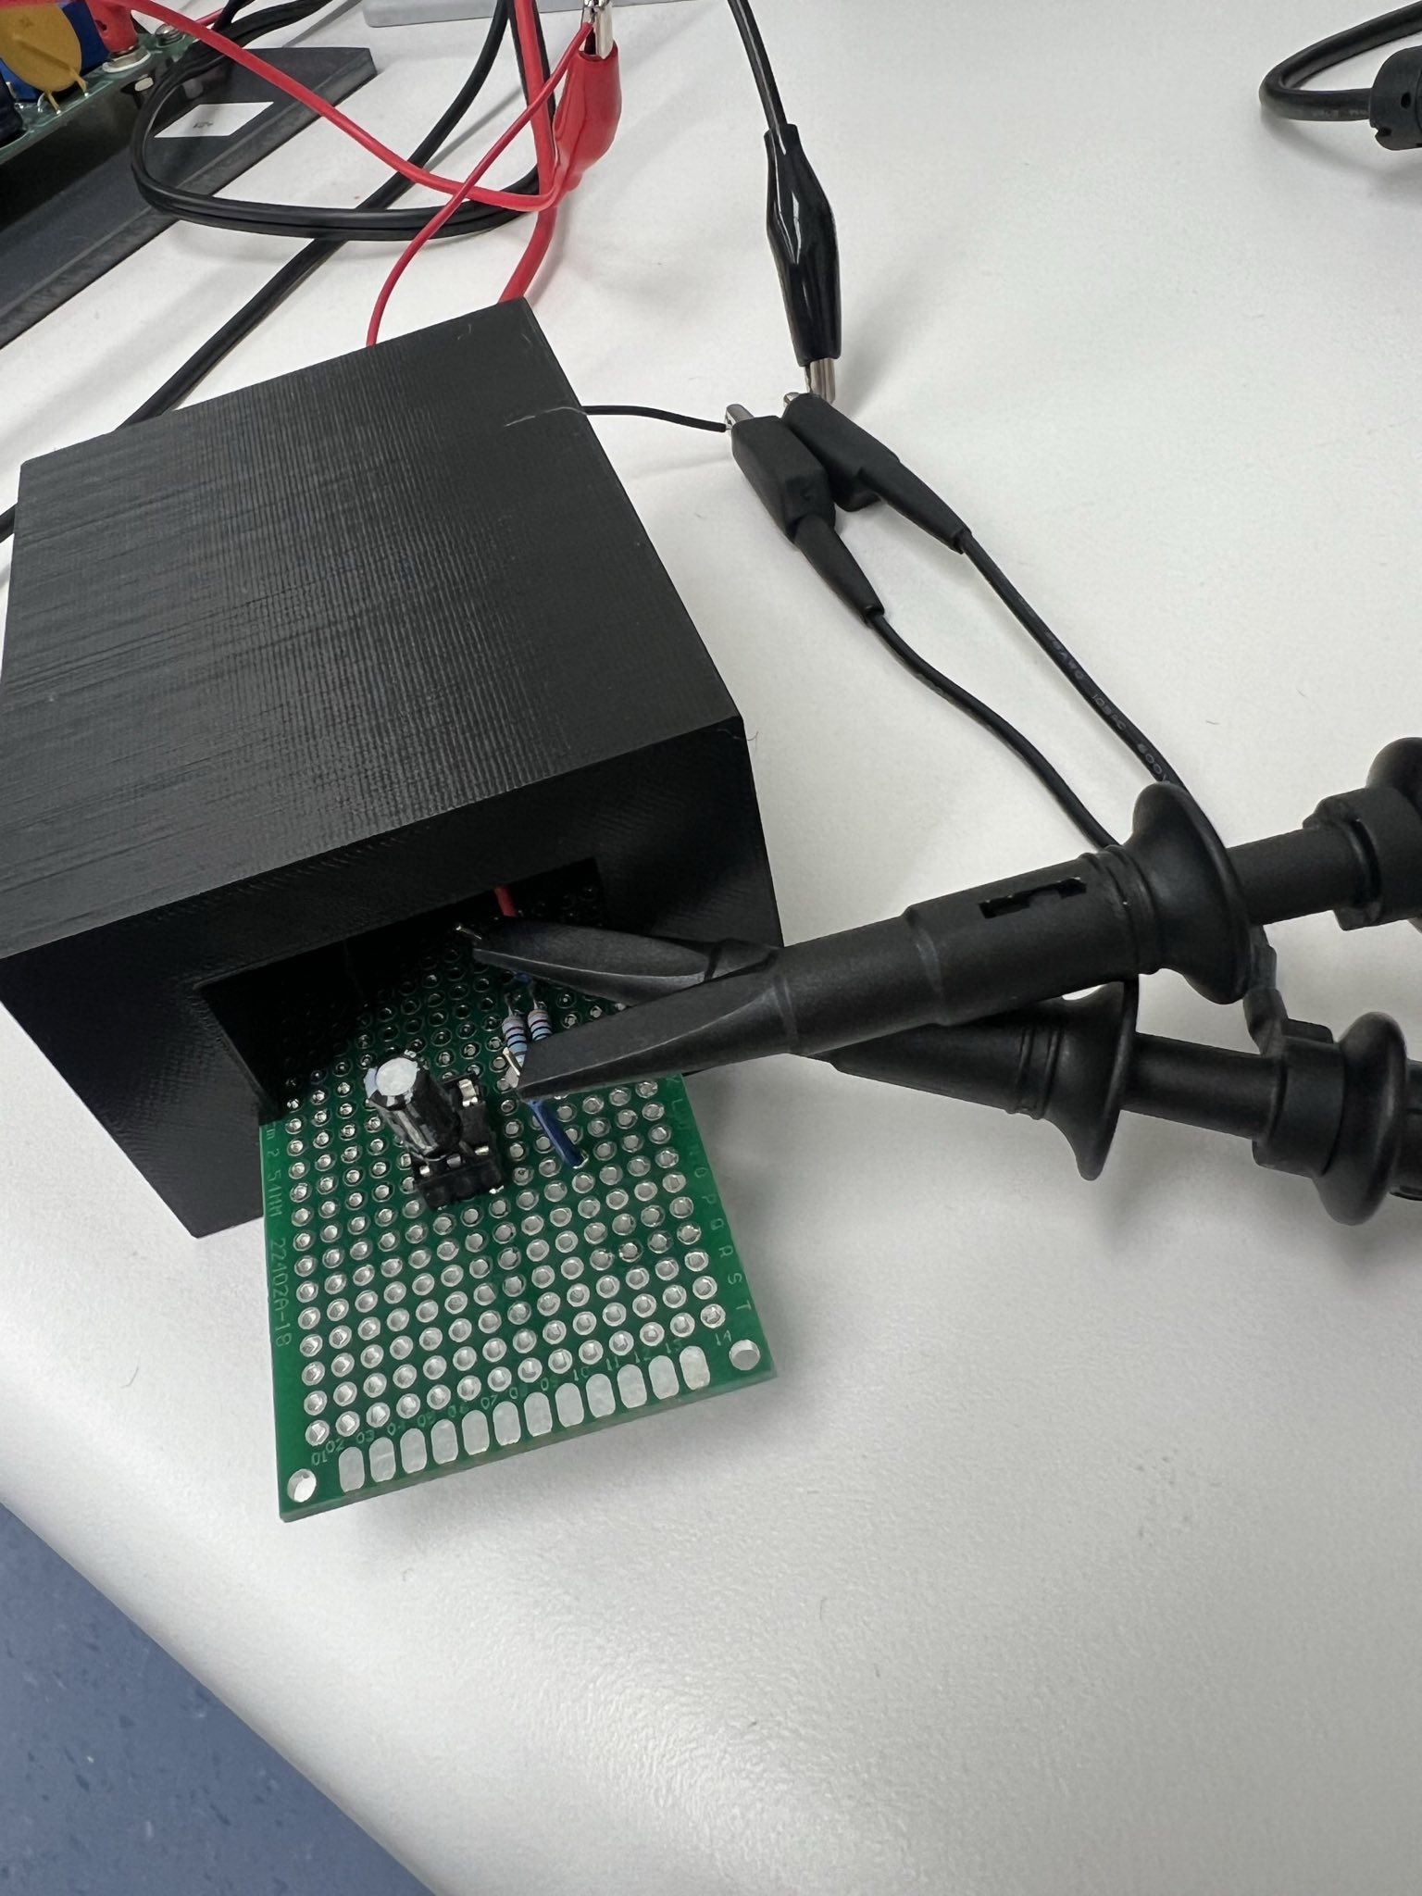



Experimental Setup
6
Notes:
Jess: A box was designed and 3d printed to contain the component under test while allowing for measurements to still be taken in order to ensure participant safety
Equipment settings needed to be confirmed and reset each time a component was swapped in/out to ensure consistent readings across all measurements.

Slide 7
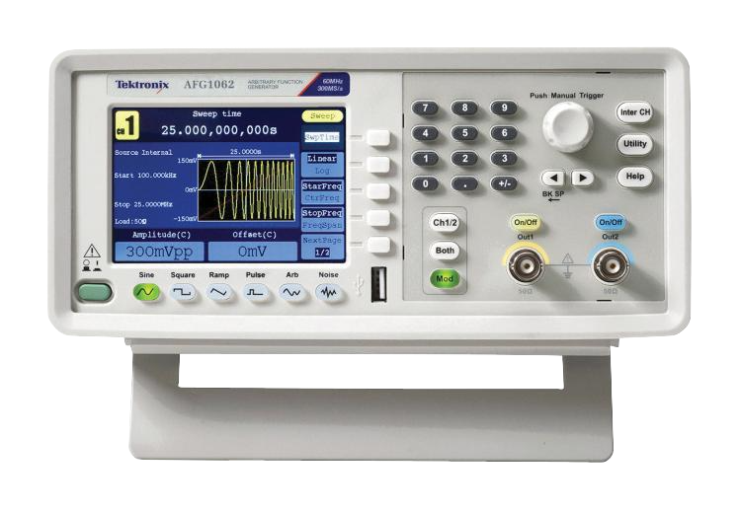
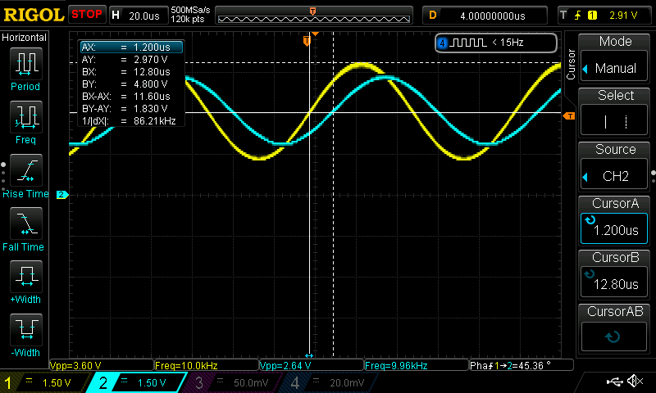
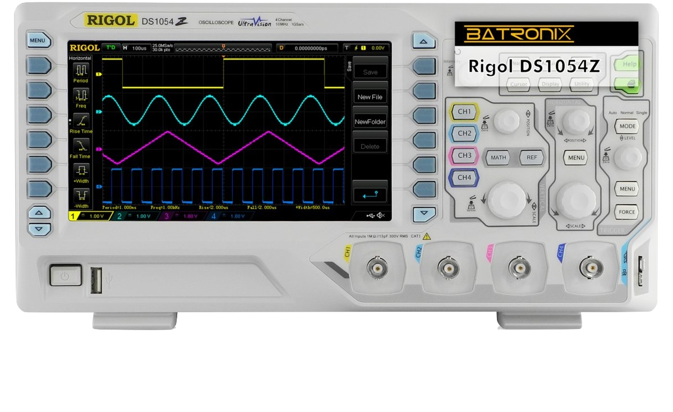
Taking Measurements
7
Notes:
// make picture with white background and make voltages bigger
// NOTE: I added pics of tools to get rid of words, you can change to your liking -Claire
Jess: Measurements were taken on a digital storage oscilloscope and offloaded in the form of a csv file.

Slide 8
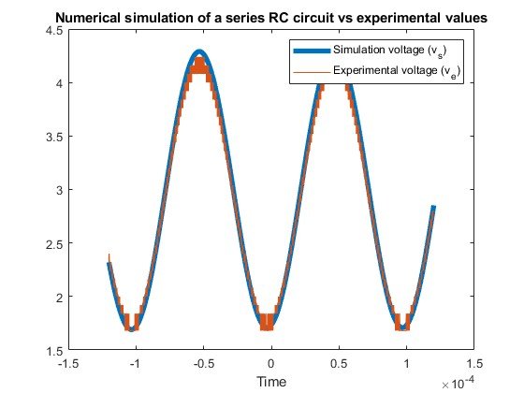
Evaluation
8
Notes:
Caroline (Jess): This experimental voltage data was compared to the virtual twin and then synchronized in Matlab. This is achieved by taking the first voltage value from the experimental data and inputting it into the model and synchronizing the virtual input signal to the experimental data. The synchronized data is then compared to determine how close the experimental data is to the theoretical ideal values.
As we can see here, with our virtual twin in blue and our experimental data in orange we have a root mean square error of only 77.9 millivolts.
This can currently only determine if the circuit has already reached a failure condition. We hope to expand this to predict when the circuit will fail.

Slide 9
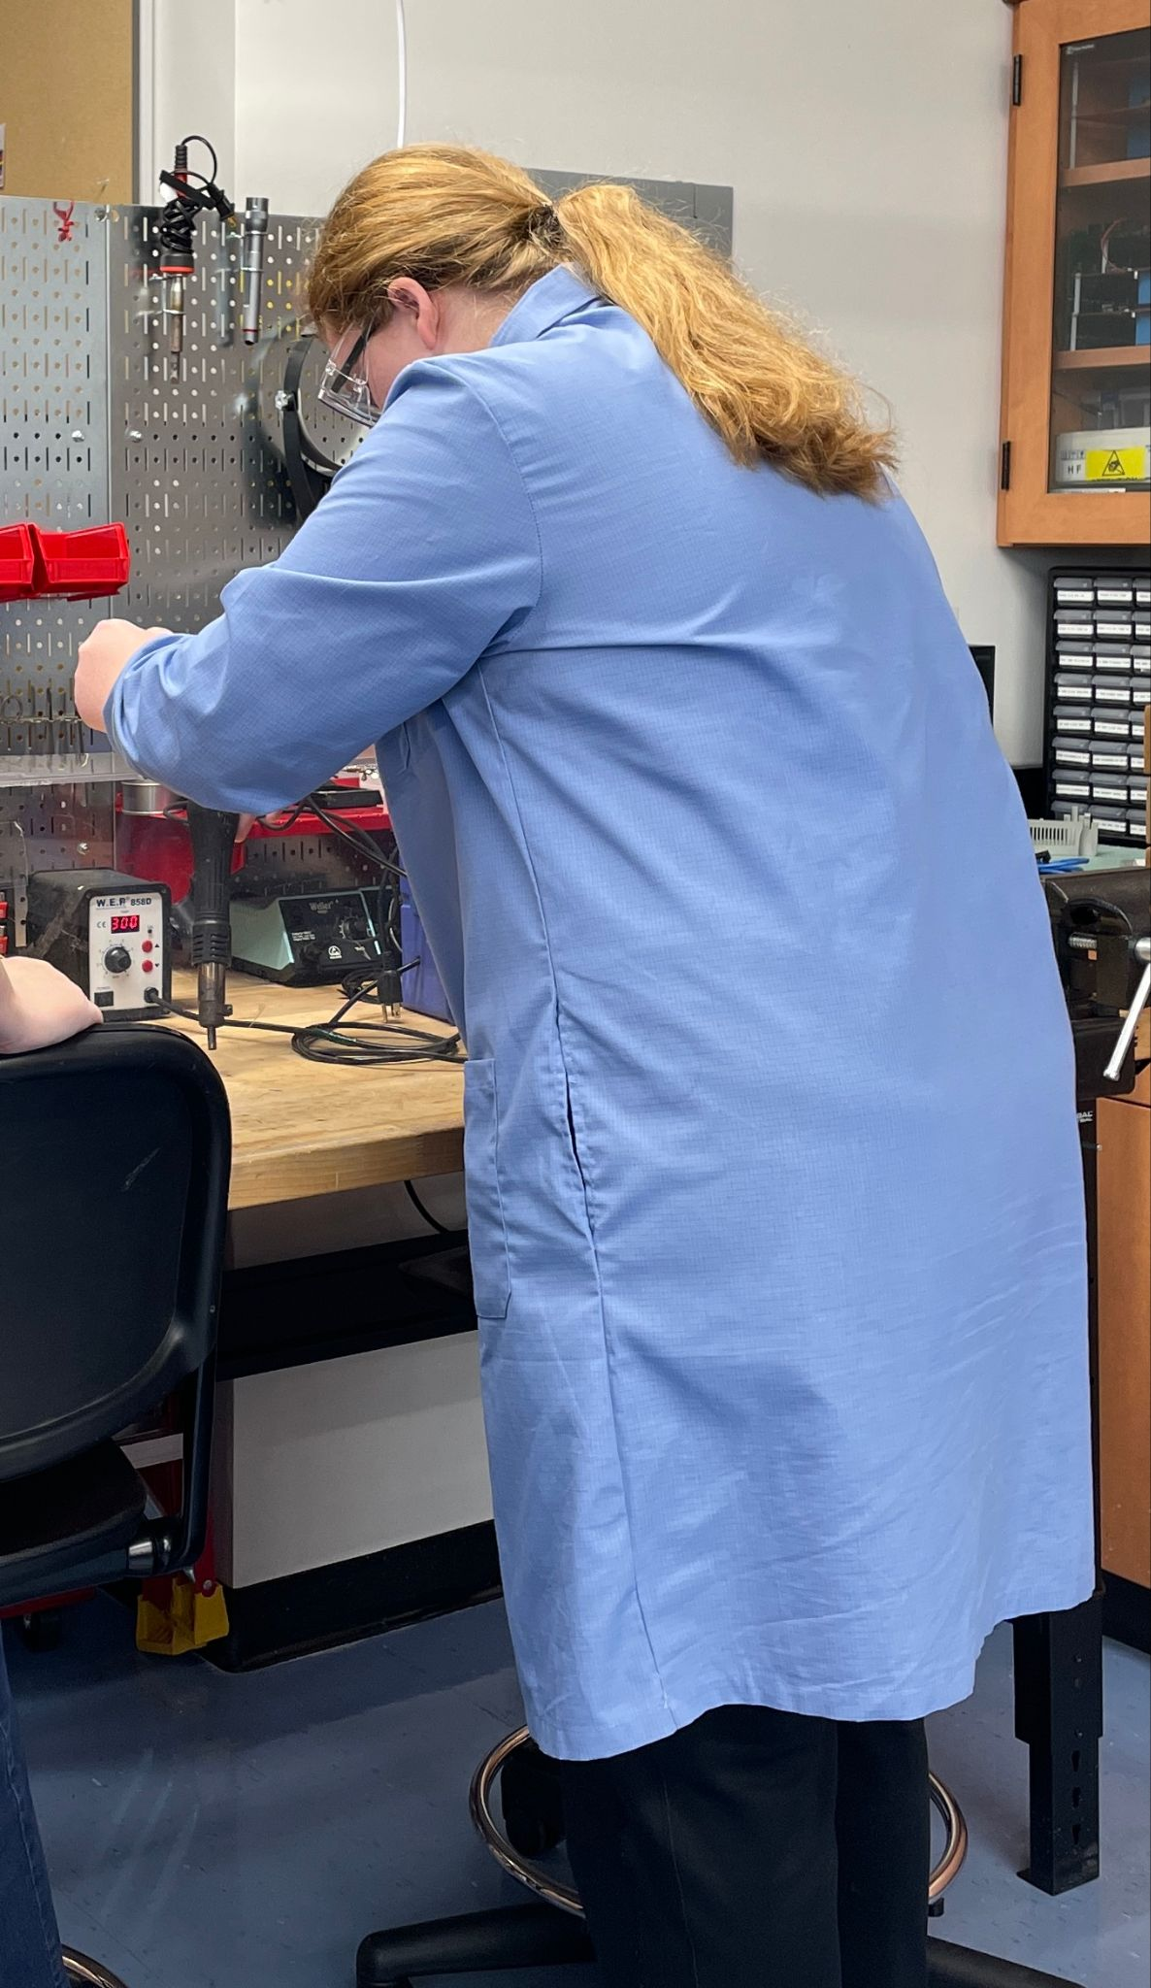



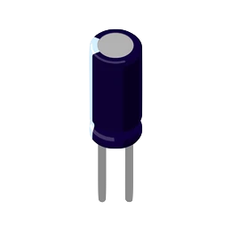
Aging Capacitors
9
Notes:
Claire: A large part of our project is building our database of capacitor health data for use with our digital twin. In order to gather data of capacitors at different stages of their life cycles, we need to age the capacitors and take measurements throughout the aging process. Once we have a collection of varying health data, we hope to be able to estimate where in the health life cycle a capacitor is at based on the different measured capacitor characteristics.
Some techniques we want to attempt to age the capacitors are heating up the capacitor and overvoltaging the capacitor., and running the capacitor at high frequencies.
Aging:
Temp: heat capacitor inside toaster oven, test up to 170 degrees Celsius
High voltage: apply voltage across the capacitor that is higher than the capacitor’s rated votage, needs supervision
High frequency: apply high frequency signal across capacitor that is higher than the capacitor’s corner frequency, doesn’t need to be supervised
As Jess briefly mentioned, we created safety procedures in preparation for this capacitor aging process to ensure the safety of ourselves and the equipment. One main topic the safety procedures include is wearing proper personal protective equipment, as demonstrated by Caroline on this slide.

Slide 10
Future Work
J-Term:
Artificially age a set of capacitors for testing
Gather performance data on the aging capacitors at set intervals
Spring:
Develop models of aged capacitors
Develop routine to estimate age of capacitors via experimental data
Rewrite programs in Rust to run on embedded system
10
Notes:
// bullet point icons
Caroline (Jess):
Over J-term we will follow the procedures outlined by Claire and collect data on these capacitors throughout the process.
In the spring we will develop state space models of the aged capacitors. The models may be different for each aging method at various points along the aging process.
The comparison procedure will be expanded to identify which model is most similar to the experimental data. It will also estimate how long it will take for the capacitor to reach failure.
Lastly, given enough time we would like to rewrite the matlab programs in Rust to run on a dedicated embedded system to monitor the system remotely.

Slide 11
11
Notes:
Claire: We have learned a lot throughout this research process so far this semester, and we look forward to where this project will take us! Thank you all for listening, do you have any questions?

